Slide 1

Open Data Marketplace
June 2018 v1 for BBC Hack

Slide 2


Introducing OneTRANSPORT - A Data Marketplace for Smart Cities
“The free flow of transport data underpins the development of new mobility solutions that provide integrated, efficient and sustainable transport systems for people and goods.”
Transport Systems Catapult report on Data Sharing in the Intelligent Mobility Sector, May 2017

Slide 3
Enabling Intelligent Mobility services across the UK
Intelligent Mobility services are increasingly disrupting the traditional transport eco-system. New technologies, services and business models are improving the travel experience, and are increasingly enhancing outcomes in health and social care, the environment and regional economic activity.
UK government highlights Intelligent Mobility as one of the 4 focus areas for its Industrial Strategy, with significant policy development and investment by BEIS and the Department for Transport, enabling world-leading technologies, capabilities and regulatory and insurance regimes to be developed in the UK that benefit UK citizens and power long-term UK economic growth.
Data is the fuel for Intelligent Mobility services, and the open sharing of local authority-owned transport data is essential to see the benefits of Intelligent Transport solutions realised in the towns and regions outside the UK’s major cities.
oneTRANSPORT helps Local Authorities to share their data nationally, maximising the exploitation of this valuable asset and enabling national data-driven Intelligent Mobility solutions and services to be customised and delivered locally.

Slide 4






Breaking Down the Silos!
oneTRANSPORTTM enables data to be shared, unlocking innovation and enabling new Intelligent Mobility Services
£
Standardised cloud-based system, built for real-time data
Publishers / Consumers
(raw data)
Enhancers
(improve data value)
Publishers / Consumers
(quality data)
Commercial and technical framework for optional selling / buying data
Open Data Marketplace
TM
Integration with both existing/legacy data systems and greenfield sensor deployments
Non-exclusive, open licenses for data sharing
Data – Driven Solutions

Slide 5
oneTRANSPORT
We provide a very cost effective means for public sector and private sector data to be stored and archived in the cloud (Azure), and subsequently shared with public and private sector organisations, enabling maximum exploitation of datasets in commercial and non-commercial applications and preventing vendor lock-in.
oneTRANSPORT acts as a neutral broker for real time and static data. We don’t offer any specific data application services that might create a conflict of interest, hence we can ensure that individual data sets reach the widest possible global audience for exploitation by individual best-of-breed organisations developing new Intelligent Transport services and solutions.
Access is via Portal for administration, data discovery and publishing, API for data stream upload and consumption – The portal provides easy way to select licenses for data publishing and view and accept licenses for data consumption. In addition to viewing latest instance of data and downloading of static data files and support information
oneTRANSPORT enables data publishers to optionally and flexibly monetise valuable data, providing a means to generate revenue without creating contract with every individual data consumer, by sharing through the system.

Slide 6
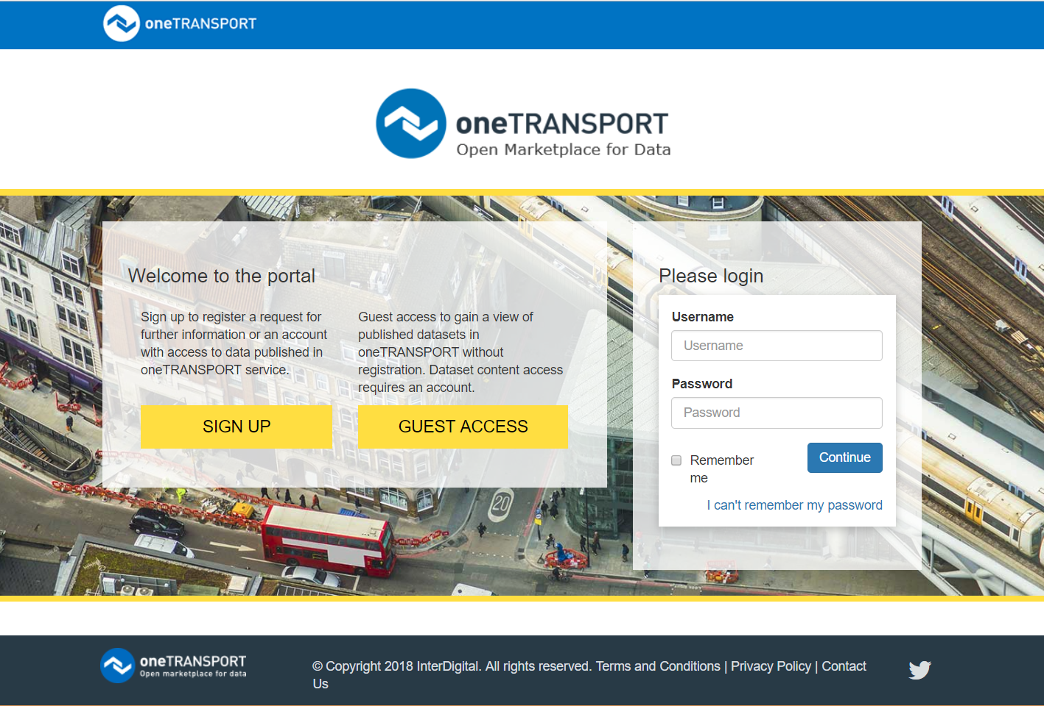
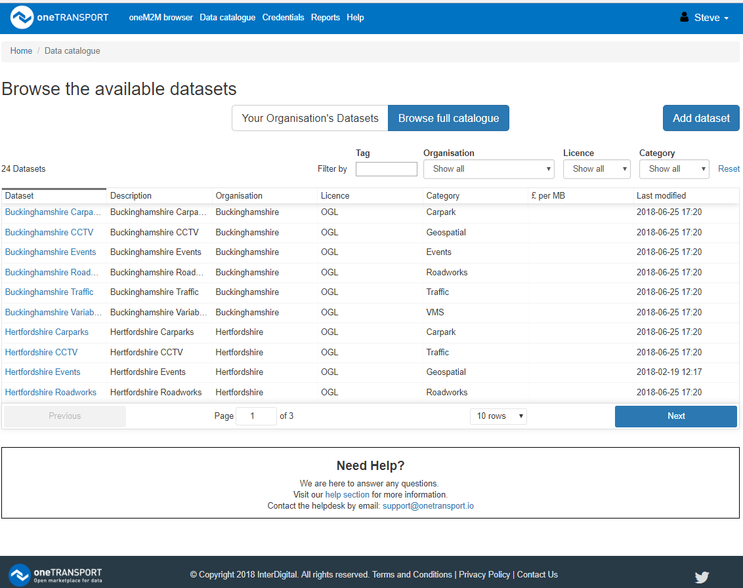
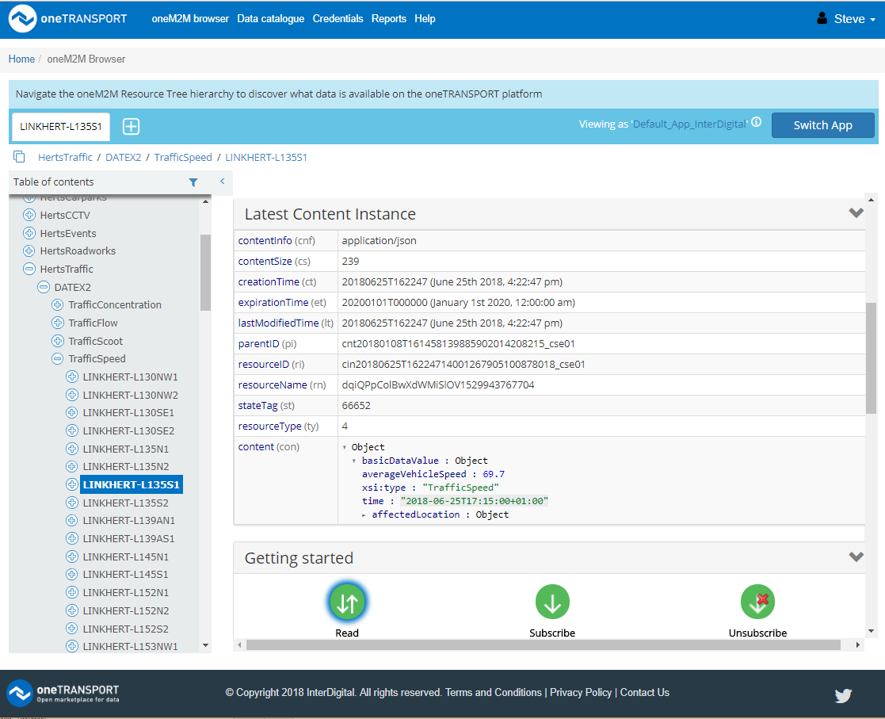
oneTRANSPORT portal – oneTRANSPORT.io

Slide 7


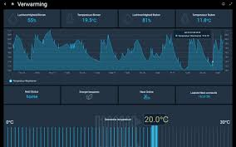


oneTRANSPORT Service Features
Holds your real-time and reference data in the cloud, with auto-archiving of historical real-time data to files
Shares your data privately across your organisation via web interface or through standardised APIs
Makes real-time data discoverable and accessible to others via standard licenses, and enables you to monitor who is consuming your data
Enables you to discover and consume data that others have published through oneTRANSPORT, via standard license terms
Allows you to set a price for your data or give it away for free, enabling monetisation of valuable information
Trusted eco-system for shared services
Benefits to Transport Operators
Enable innovators to create new Intelligent Mobility Services that are powered by your data and integrated with your services
Incorporate third party data to improve your service delivery
Monetise your data assets
Benefits to Public Transport Authorities
Share data between regional and local authorities and across authority boundaries. Understand your region better.
Store your data in the cloud and open it to private sector service innovators via government-friendly license terms
Benefits to Technology / Service / Solution providers
Discover new service opportunities and efficiency savings
Deliver your service across multiple geographies
Open your data to others, and monetise valuable data

Slide 8
Data available for BBC Hack event
Local authority datasets - Buckinghamshire, Hertfordshire, Oxfordshire, Northamptonshire.
Carparks – Occupancy, fill rates
ANPR cameras – Journey time
Traffic signals – ‘Scoot loop triggers’, Flow, congestion, (speed)
Variable message signs – current display
CCTV – Location only
Roadworks / Events – planned and emergency
Data sources are in Datex II format http://www.datex2.eu/content/datex-ii-xml-schema-20-rc1
Birmingham city data
Carparks – Occupancy
Variable message signs
ANPR – journey time
Traffic – flow, speed,signals
Data sources are in CSV format imported from UTMC feed

Slide 9
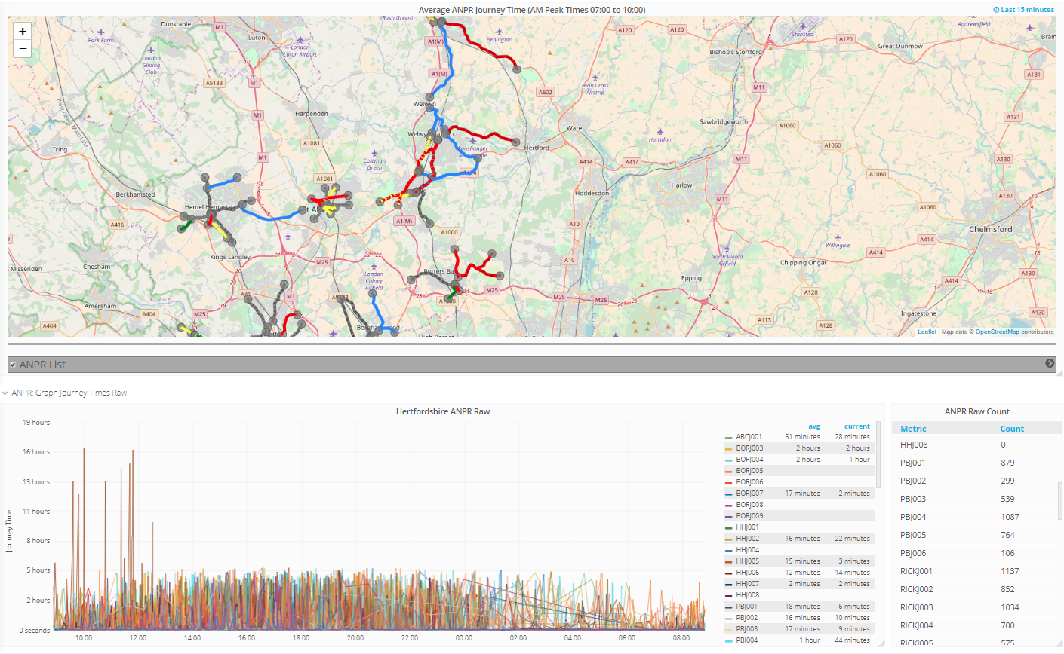
oneTRANSPORT Hertfordshire Journey times

Slide 10
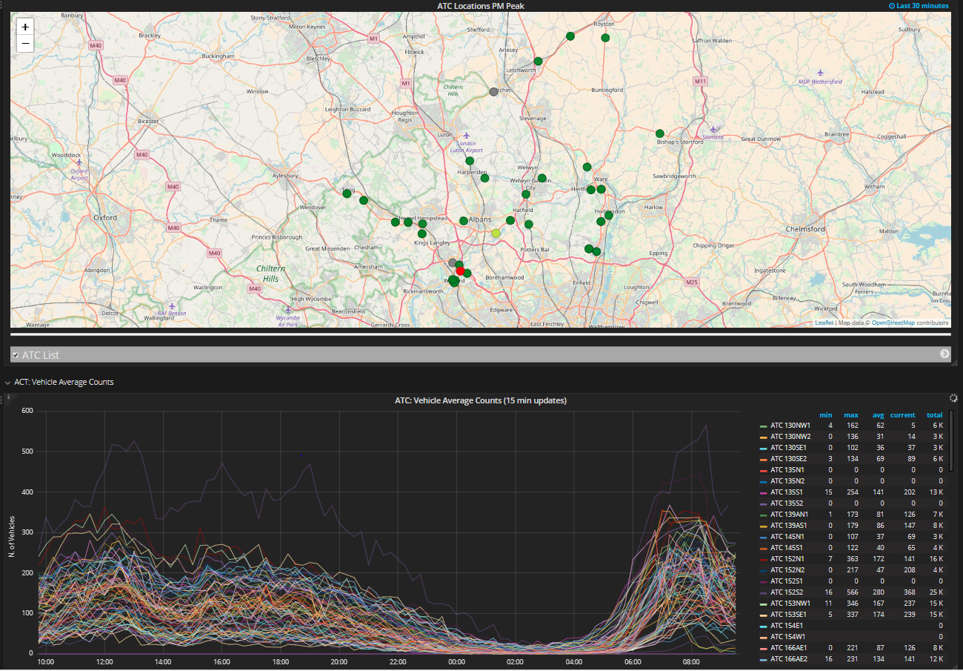
oneTRANSPORT Herts Traffic count sensors

Slide 11
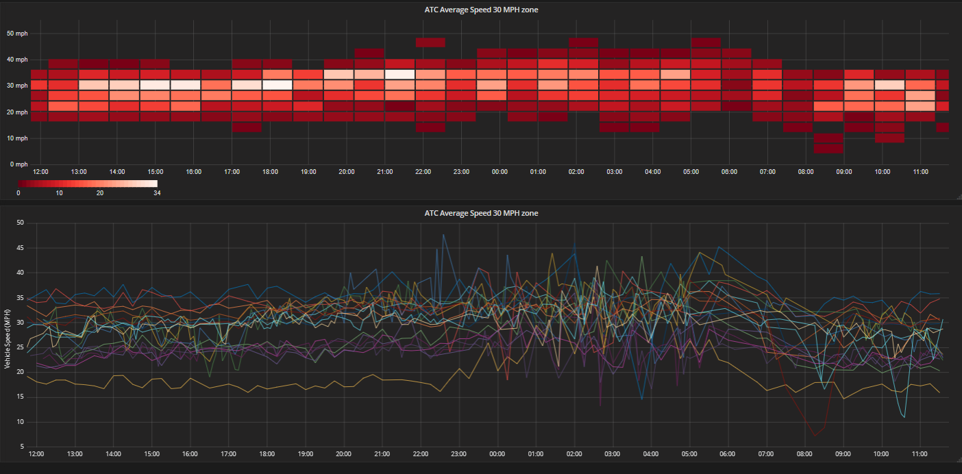
oneTRANSPORT Herts 30 Zone analysis

Slide 12

For more information contact :
info@oneTRANSPORT.io

